Slide 1
Combatting SMiShing Attacks: Strategies for Enhanced Cybersecurity

Slide 2
TITLE:SMISHING
NAME:D.PRADEEP KUMAR
REG.NO:110121104075
COLLAGE:AALIM MUHAMMED SALEGH COLLAGE OF ENGINEERING
DEPARTMENT: COMPUTER SCIENCE ENGINEERING

Slide 3




Introduction
In today's digital landscape, SMiShing attacks pose a signiﬁcant threat to cybersecurity. This presentation will explore effective strategies to combat these malicious attempts to steal sensitive information through SMS phishing.

Slide 4


Understanding SMiShing
SMiShing involves fraudulent text messages designed to trick recipients into revealing sensitive information or clicking on malicious links. Attackers often impersonate reputable organizations, exploiting trust to deceive victims.

Slide 5
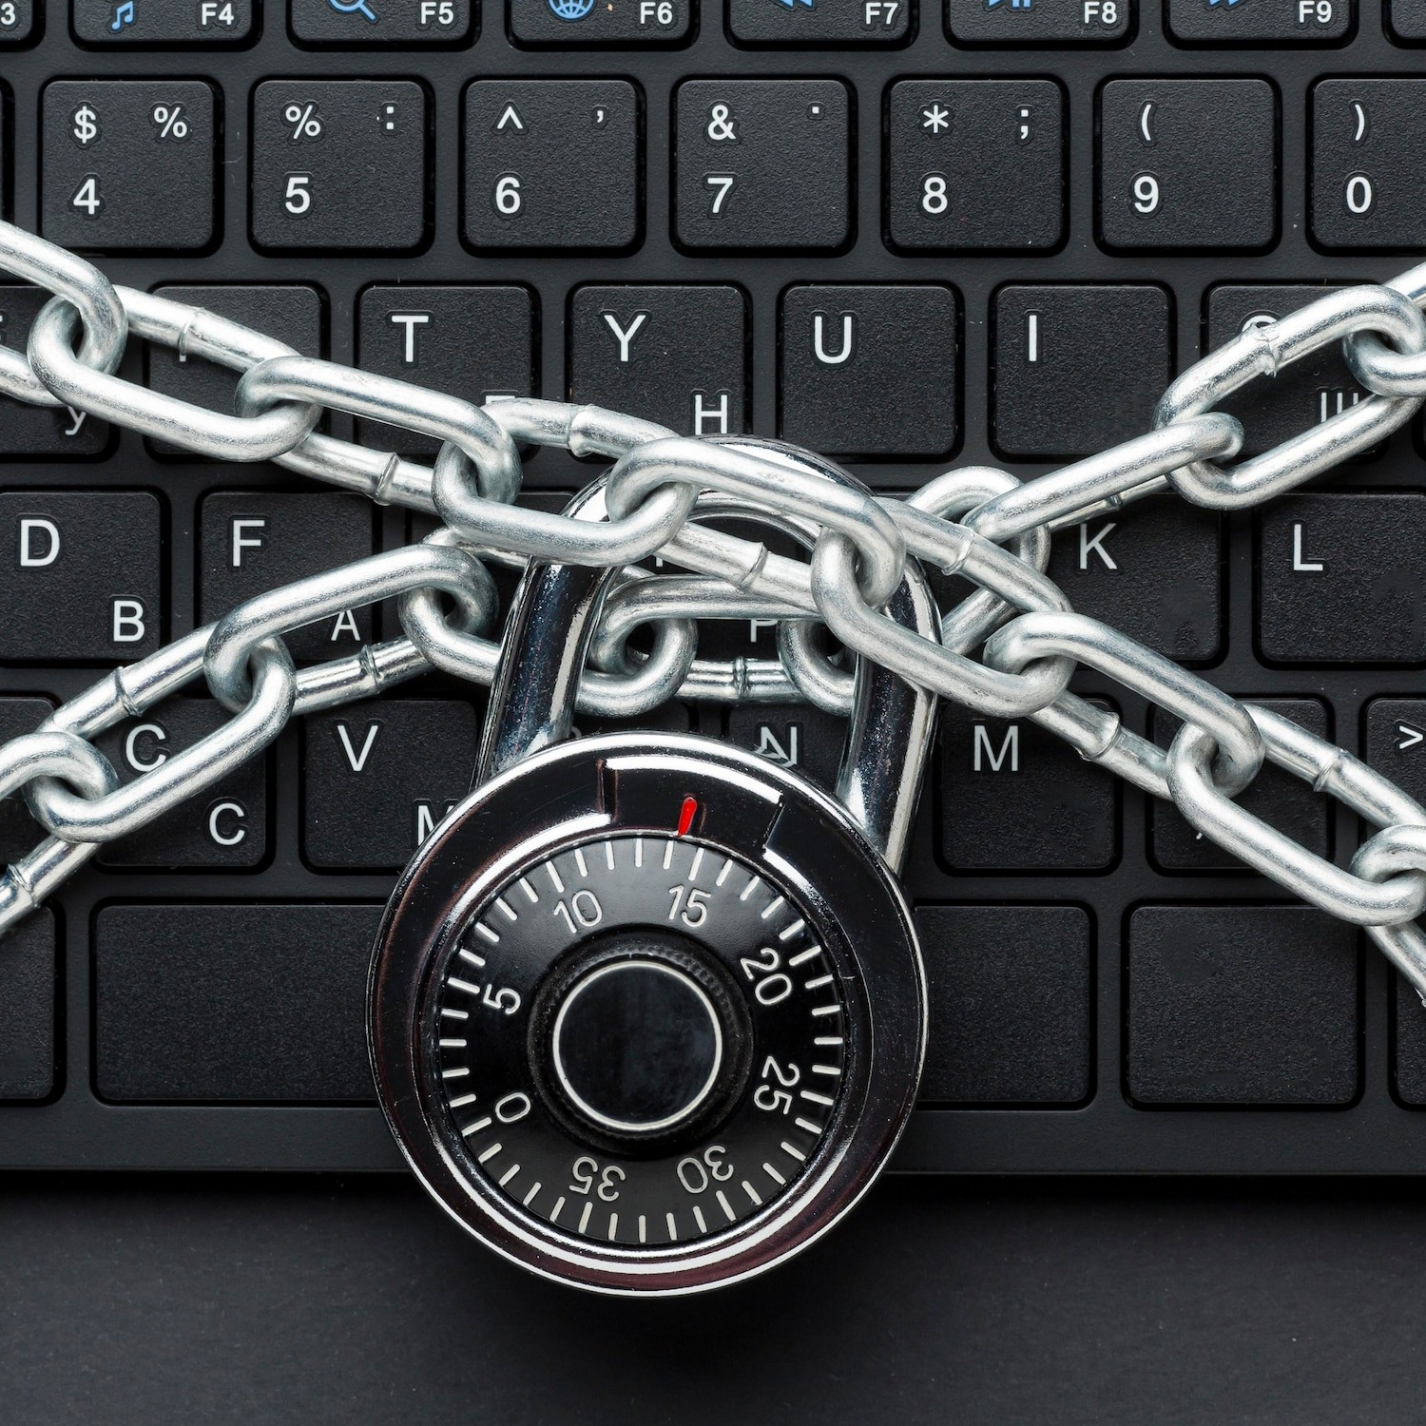
Risks and Impacts
SMiShing attacks can result in unauthorized access to personal and ﬁnancial data, leading to identity theft, ﬁnancial losses, and reputational damage. It is essential to recognize the severity of these threats and take proactive measures to mitigate risks.

Slide 6




Implementing multi-factor authentication, educating users about phishing awareness, and deploying SMS ﬁltering technologies are effective preventive measures against SMiShing attacks. Regular security assessments and updates are crucial for maintaining robust defenses.

Slide 7




Response and Recovery
In the event of a SMiShing incident, swift incident response and forensic analysis are essential. Organizations should also have a comprehensive data recovery plan to minimize the impact of successful SMiShing attacks.

Slide 8





Conclusion
Combatting SMiShing attacks requires a proactive and multifaceted approach, encompassing awareness, technological defenses, and response readiness. By staying vigilant and continuously improving security measures, organizations can effectively safeguard against these pervasive cyber threats.

Slide 9
Thanks!

